Slide 1
UMASS Meal Planner
USE CASES
Group 6: Eduardo, Fuming, Arvind Manager: Srihari

Slide 2
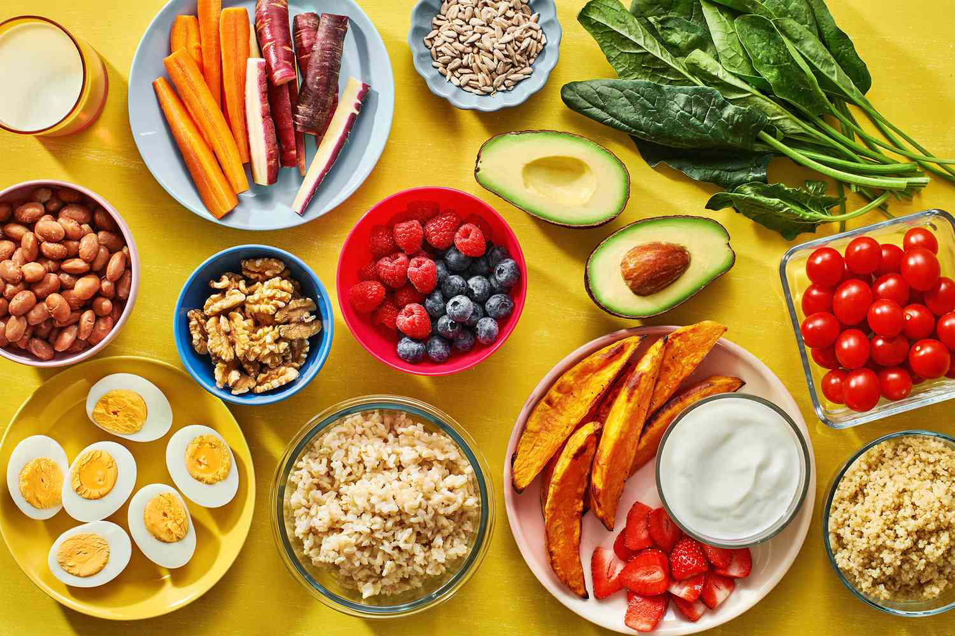
Description
Input dietary restriction, macro/micros, calorie count, protein, and preferred dining hall into a filter.
Generate meals that satisfy those condition
Automatically save meal
Save dietary restrictions
If no match, closest meals shown

Slide 3
USE Case 1: Planner
Goal: | Plan a meal
Description: | Main task performed by app User inputs filters, and system returns a planned meal.
Actors: | Umass Students (Users) Umass Employees (Users) Umass Visitors (Users)
Pre conditions: | Umass employee/student logged on Input dietary restrictions

Slide 4
Success end condition: | Have a meal and a location planned with preferred input restrictions.
Failure end condition: | Failed search result Failed meal generated Failed logging in
Trigger: | User inputs restrictions and filters
Exceptions: | Filter is empty (it will show random meals generated)
Alternative scenarios: | None

Slide 5
Main Success Scenarios
01
Patron select bubbles or inputs to filters (select macros)
02
The system finds a matching meal and presents it with a dining hall

Slide 6
Error Scenarios
01
Patron inputs wrong password
02
There is no match for a meal, then give suggestions with the closest macros.

Slide 7
USE Case 2: Account
Goal: | Create an account for app use
Description: | Create an account for save meals
Actors: | Umass Students (Users) Umass Employees (Users) Umass Visitors (Users)
Pre conditions: | Open app

Slide 8
Success end condition: | Successfully login or set up an account with dietary restrictions
Failure end condition: | Failed account setup Failed logging in No dietary restrictions saved
Trigger: | Clicks on login/signup for an account
Exceptions: | Filter is empty (no preferences saved)
Alternative scenarios: | Visitor login, which won’t save meals, only recommends it

Slide 9
Main Success Scenario
01
System presents a screen to set up an account, with email, name, password and tables and filters for dietary restrictions/preferences
02
Patron select bubbles or inputs to filters, fill up email, password, and confirm password
03
The system saves the user information and applies any filters

Slide 10
Error Scenarios
01
Email already used when signing up.
02
Patron forgot password.

Slide 11
USE Case 3: Check Nutritional Values
Goal: | Check nutritional values of a meal
Description: | After meal selection check individual items nutritional values
Actors: | Umass Students (Users) Umass Employees (Users) Umass Visitors (Users)
Pre conditions: | Patron logged on Patron generated and saved meal.

Slide 12
Success end condition: | Show nutritional values for a particular item
Failure end condition: | Fail to show nutritional values
Trigger: | After selecting meal, select an individual item
Exceptions: | No nutritional information for that item.
Alternative scenarios: | N/A

Slide 13
Main Success Scenario
01
Patron selects the item he wants
02
System shows nutritional information on the item

Slide 14
Error Scenarios
01
No nutritional information available.

